Slide 1

课时练习
期末复习二 模块七 第二章

Slide 2
一、根据语境、 音标或所给单词的提示完成句子， 每空一词。
1. It’s unhealthy to eat too much _______ food like hamburgers or potato chips.
2. What I really want is to live _________ (health) for as long as possible.
3. The poor beggar(乞丐) was so hungry that he ate four ________ (bowl) of rice.
junk
healthily
bowls

Slide 3
一、根据语境、 音标或所给单词的提示完成句子， 每空一词。
4. When family members dine together, they should use serving(分菜用的) ____________ /'tʃɒpstɪks/ and spoons.
5. If you sound too busy on the phone, the caller will think you are _________ (polite).
chopsticks
impolite

Slide 4
二、 重点句型。
1. 但我不确定我能不能把它煮好。
But I’m not sure __________________________.
2. 你介意我们向你学做三明治吗？
Would you mind if _________________________
________________________________________?
3. 吃完你盘子里的食物是礼貌的。
It’s _________________________ on your plate.
whether/if I can cook it well
we learn to make sandwiches from you
polite to eat up the food

Slide 5
二、 重点句型。
4. 记得不要喝太多。
Remember _______________________.
5. 世界各地的人们有不同的饮食习惯。
People around _____________________
__________________________________.
not to drink too much
the world have different eating habits

Slide 6
三、重点语法。
★ 宾语从句 Ⅱ
(A)根据所学知识，将横线上的内容补充完整。
将一般疑问句变为宾语从句时，用连词 ______ 或 ________ 引导。这两个连词在从句中不充当句子成分， 但有含义，意为 “______”，故不可省略。一般疑问句变为宾语从句时，原来的疑问语序需改为 ______ 语序。
whether和if引导宾语从句时，一般可以互换，但句中有or not时，一般用whether.
if
whether
是否
陈述

Slide 7
三、重点语法。
(B)根据中文提示完成英语句子。 (每条横线不限词数。)
1. 我不确定我明天是否会早到。
I’m not sure __________________________________.
2. 我想知道他们昨天上班是否迟到了。
I want to know _______________________________
yesterday.
whether/if I will arrive early tomorrow
whether/if they were late for work

Slide 8
三、重点语法。
3. 你能告诉我Rick是否正在图书馆看书吗？
Can you tell me ______________________________
____________________________________________?
4. 我不知道昨天这个时候我妈妈是否正在做饭。
I don’t know ______________________________ or not at this time yesterday.
whether/if Rick is reading (books) in the library
whether my mother was cooking

Slide 9
三、重点语法。
5. 你知道他们昨天是否完成工作了吗？
Do you know __________________________
_____________________________________?
whether/if they finished the/ their work yesterday

Slide 10
四、单项选择。
( )1. —Would you mind teaching me to make dumplings?
—_______. You can do like this.
A. Certainly not B. You’d better not
C. Never mind
A

Slide 11
四、单项选择。
( )2. _______ we need more food or not depends on how many people show up.
A. If B. That C. Whether
C

Slide 12
四、单项选择。
( )3. —Bob, could you please help me _______ the bottle _______ water?
—With pleasure. I’ll do it right away.
A. fill; in B. fill; with C. add; to
B

Slide 13
四、单项选择。
( )4. Of all the animals on land, the kangaroo(袋鼠) jumps the ________.
A. far B. farther C. farthest
C

Slide 14
四、单项选择。
( )5. Remember ________ the window because the wind is blowing hard outside.
A. to open B. not to open C. opening
B

Slide 15
四、单项选择。
( )6. —Why is he sitting outside the door?
—There is ________ noise in the room and he needs peace.
A. much too B. too many C. too much
C

Slide 16
四、单项选择。
( )7. It’s of great importance to ________ giant pandas’ biology, behavior and reproduction(生殖) before feeding them.
A. know about B. talk about
C. worry about
A

Slide 17
四、单项选择。
( )8. If you go to an American family _______ the first time, you’d better _______ there earlier.
A. for; get to B. /; get C. for; arrive
C

Slide 18
四、单项选择。
( )9. My mom _______ the meat into small pieces to make dumplings.
A. build up B. cut out C. cut up
C

Slide 19
四、单项选择。
( )10. —How should we drink ________ others when there are lots of people at dinner?
—In China, we should start _______ the old.
A. for; with B. to; with C. to; at
B

Slide 20
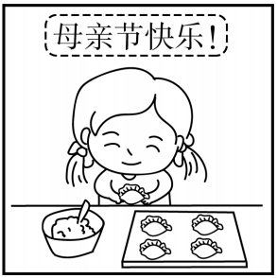
五、看图写话。
1. for, on
The girl makes/made dumplings for her mother on Mother’s Day.

Slide 21
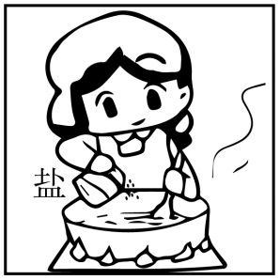
五、看图写话。
2. add … to
The girl/She added/adds some salt to the soup.

Slide 22
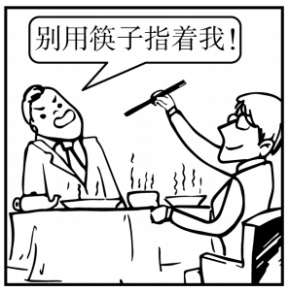
五、看图写话。
3. impolite
It’s impolite to point at others with chopsticks.

Slide 23
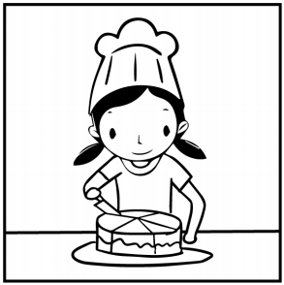
五、看图写话。
4. cut, into
The girl/She cut the cake into (five) pieces.

Slide 24
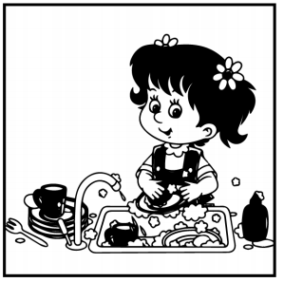
五、看图写话。
5. after dinner, yesterday
The girl/She washed/did the dishes after dinner yesterday.

Slide 25
六、情景交际。
1. 你想知道你们班谁跳得最高，可以这样问同桌：
Who _____________________________________?
2. 你想知道对方最喜欢的蔬菜是什么，可以这样问：
What’s ______________________________________?
3. 你想知道如何制作飞机模型，可以这样向哥哥请教：
Could you please tell me ________________________
_____________________________________________?
jumped the highest in our class
your favorite vegetable
how to make a model plane/ how I can make a model plane

Slide 26
六、情景交际。
4. 同桌经常吃垃圾食品，这不利于身体健康， 你可以这样劝他：
____________________________________________
____________________________________________.
5. 屋外很吵，你想让妹妹关门，可以这样说：
Would you mind __________________________?
You shouldn’t/Don’t eat too much junk food/
Eating too much junk food is bad for your health
closing the door

Slide 27
七、短文填空。
1 restaurant in India is encouraging(鼓励) people to put their leftover(吃剩的) food in a fridge outside for the 2 /'hʌŋɡri/ people to take. If people are in need of a meal, they can take food from the fridge at any time.
A/One
hungry

Slide 28
七、短文填空。
The fridge is open 24 3 (hour) a day, seven days a week and stays unlocked(未锁的). The 4 (own) of the restaurant Pauline asks people to write the 5 /deɪt/ they leave the food, so people know how long it’s been there. But most food doesn’t stay in the fridge 6 long and the food needs to be added often. Pauline herself adds around 75 to 80 portions(一份) of food every day from the restaurant in the fridge.
hours
owner
date
for

Slide 29
七、短文填空。
The idea 7 /keɪm/ to Pauline one night when she saw a lady looking for food in a trash can(垃圾桶). She was especially sad because that night, her restaurant 8 . (make) lots of food that they could have easily given the woman, instead of her looking for it. Since then, Pauline has decided to make a change, 9 wasting(浪费) no food is what Pauline is doing now.
By doing this, Pauline has helped thousands of people. And she will keep 10 (help) more if they need.
came
made
and/so
helping

Slide 30
八、阅读理解。
I always dream about returning to the past. As many people say, childhood is the happiest and easiest time in one’s life.
Children show you their true feelings. They know better than adults(成年人) what a good thing is and what a bad thing is. In their world, they show all their real thoughts. They forget easily what is not good. They may easily have different opinions from older people, but they never understand what is to hate.

Slide 31
八、阅读理解。
They enjoy making friends but they never think about making social communication(交流) net. Every child talks from his heart without evil(邪恶的) plans and never intrigues(耍阴谋) against each other. They enjoy playing in the open air and flying in their own world like birds. Things always happen beyond their expectations(期待). Kids laugh and cry easily when they meet new things. They don’t do what other people like; they only do what they like in their own ways.

Slide 32
八、阅读理解。
I wish everyone would keep as innocent and lovely as they were in their childhood. Then, we can break down the walls between our hearts, and the world would be a better place to live. That is to say, only in children’s way can we make our life simpler, more real and more enjoyable.

Slide 33
八、阅读理解。
( )1. What does the writer think of childhood?
A. It’s the happiest time in one’s life.
B. It’s the hardest time in one’s life.
C. It’s the busiest time in one’s life.
D. It’s the saddest time in one’s life.
A

Slide 34
八、阅读理解。
( )2. From the passage, we know that children like ________ in their childhood.
A. making friends B. fighting
C. flying kites D. crying
A

Slide 35
八、阅读理解。
( )3. Compared with adults, children are ______.
A. hard to work with B. kind and simple
C. unfriendly D. busy
B

Slide 36
八、阅读理解。
( )4. What does the underlined word “innocent” in Paragraph 4 mean in Chinese?
A. 成熟的 B. 天真的
C. 消极的 D. 认真的
B

Slide 37
八、阅读理解。
( )5. According to the passage, which of the following is TRUE?
A. Children hate adults.
B. All adults hope to return to the past.
C. Children always do the things they like.
D. Adults never intrigue against others.
C

Slide 38


